Slide 1
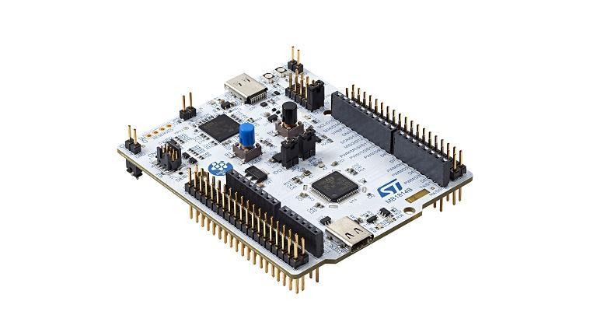
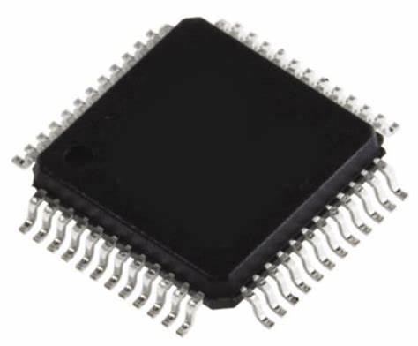

STM32 Microcontroller
Prepared by Umme Jannat Taposhi, Lecturer Department of Computer Science and Engineering, BRAC University

Slide 2
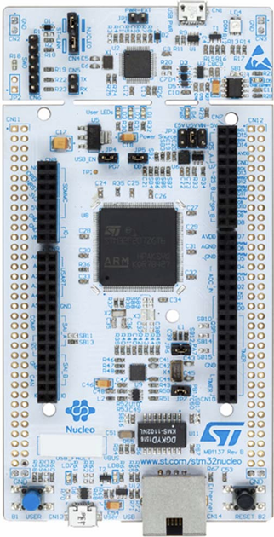
STM32 Nucleo Board
144 pin board

Slide 3
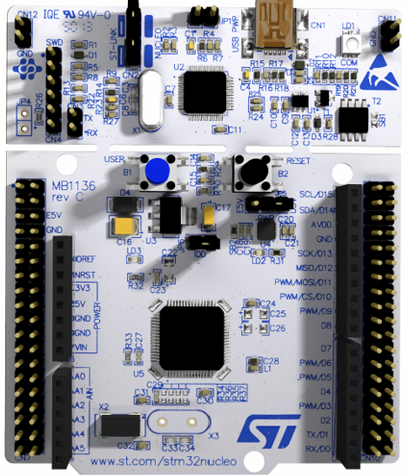
STM32 Nucleo Board
64 pin board

Slide 4
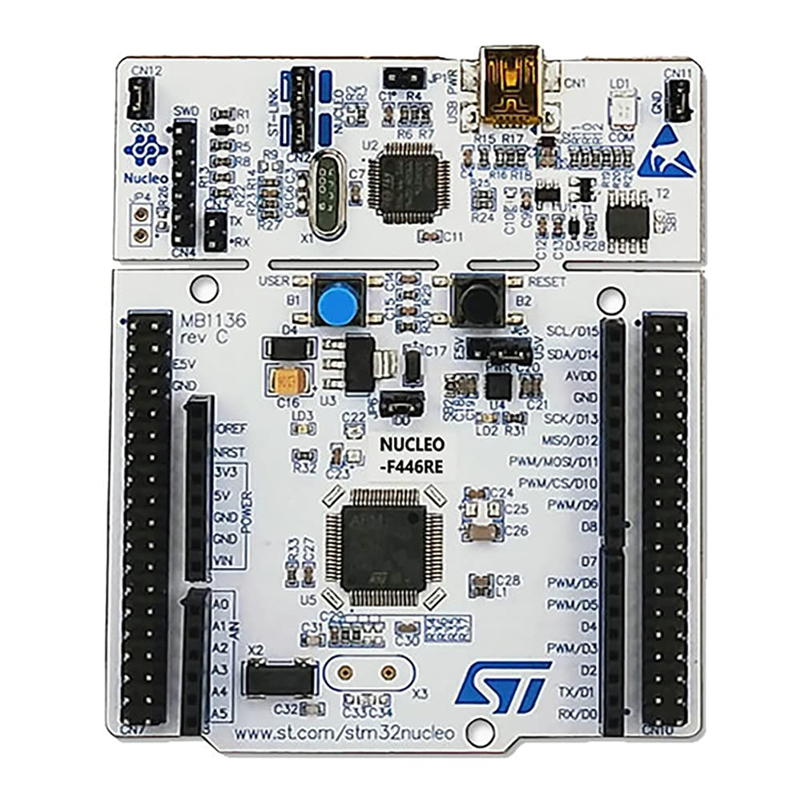
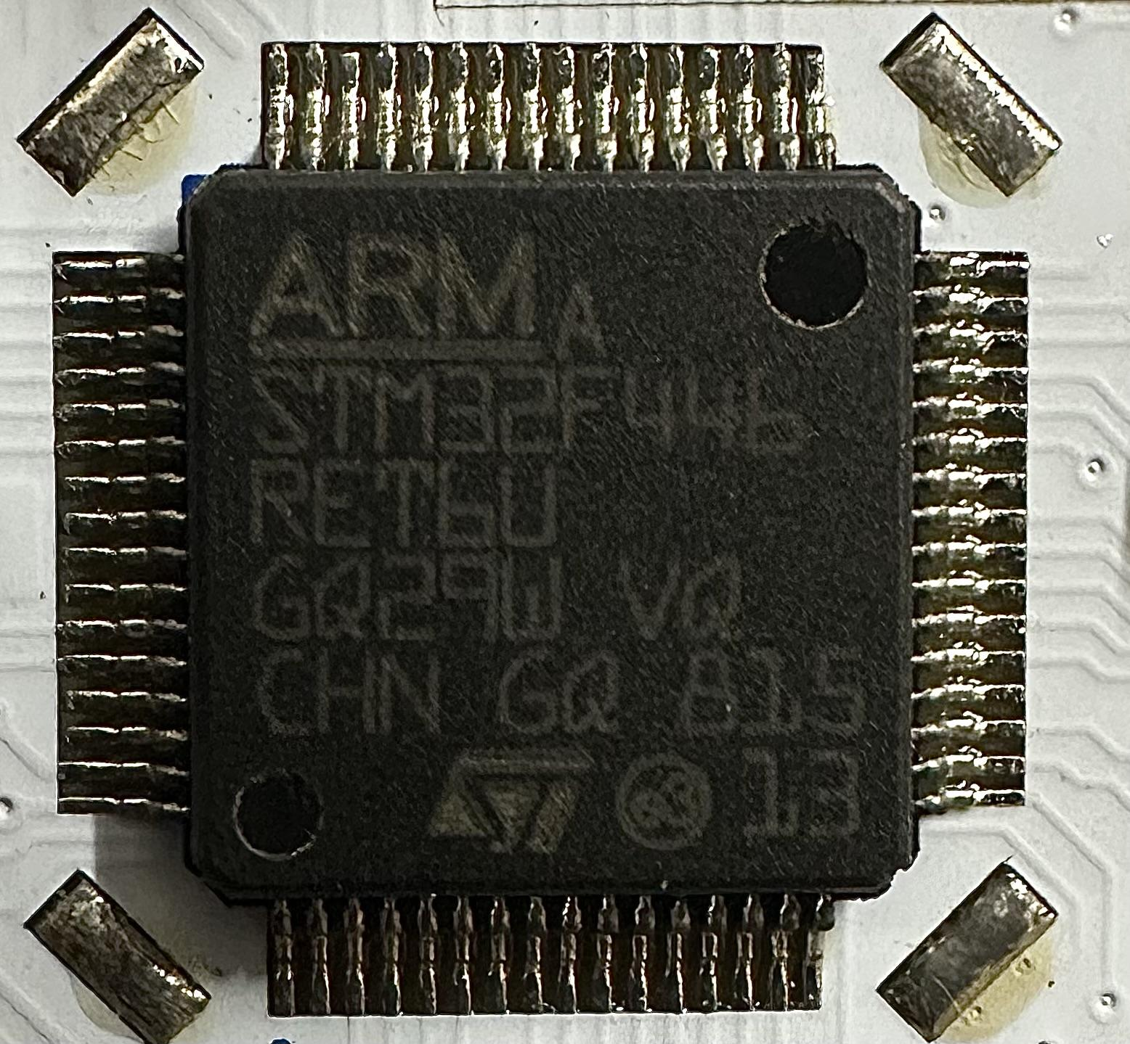
STM32F446RE
STM32F446RE Board
ARM Cortex-M4 Microcontroller

Slide 5
Why ARM processor?
Engineering
IoT research
Economy of Bangladesh
Industry machinery
Program almost all machine around us
High level hardware (ARM processor building - Trillion $ market)

Slide 6
ARM Cortex-M4
32 bit microprocessor with FPU [Floating Point Unit] core
Flash Memory & RAM (on-board)
Peripheral port/devices
Word: data of 32-bit length.
Half-word: data of 16-bit length.
Byte: data of 8-bit length.
Double word: data of 64-bit length.

Slide 7
Key Features of the ARM Cortex-M4 Core in STM32F446RE
Core Architecture
ARM Cortex-M4: A 32-bit RISC processor core designed for high performance and low power consumption.
DSP Instructions: The Cortex-M4 includes a set of digital signal processing (DSP) instructions that enhance its performance in applications requiring complex mathematical computations.
Floating Point Unit (FPU): Supports single-precision floating-point operations, which is beneficial for applications involving arithmetic operations with real numbers.

Slide 8
Key Features of the ARM Cortex-M4 Core in STM32F446RE
2. Performance
Clock Speed: Can operate at up to 180 MHz, providing high processing power for complex applications.
Harvard Architecture: Features separate instruction and data buses, allowing simultaneous access to memory and instructions.
3. Memory
Flash Memory: 512 KB of on-chip Flash memory for program storage.
SRAM: 128 KB of SRAM for data storage.
Memory Protection Unit (MPU): Enhances security by allowing control over memory access permissions.

Slide 9
Key Features of the ARM Cortex-M4 Core in STM32F446RE
4. Interrupt System
Nested Vectored Interrupt Controller (NVIC): Supports efficient handling of interrupts with 16 levels of priority.
SysTick Timer: A dedicated timer for generating system ticks, useful for real-time operating systems.
5. Peripherals
Timers: Multiple general-purpose timers, advanced-control timers, and basic timers for timing and counting applications.
Analog Peripherals: Includes ADCs (Analog-to-Digital Converters), DACs (Digital-to-Analog Converters), and comparators.

Slide 10
Key Features of the ARM Cortex-M4 Core in STM32F446RE
7. Communication Interfaces:
UART/USART: For asynchronous and synchronous serial communication.
SPI: For synchronous serial communication with peripherals like sensors and memory devices.
I2C: For communication with low-speed peripherals.
CAN: For automotive and industrial communication networks.
USB: Supports both Host and Device modes.
GPIO: General-purpose input/output pins for interfacing with external components.

Slide 11
Key Features of the ARM Cortex-M4 Core in STM32F446RE
8. Debug and Trace
Embedded Trace Macrocell (ETM): Provides real-time trace capabilities for debugging complex applications.
Serial Wire Debug (SWD): A two-pin protocol for debugging, offering a reduced pin count compared to JTAG.

Slide 12
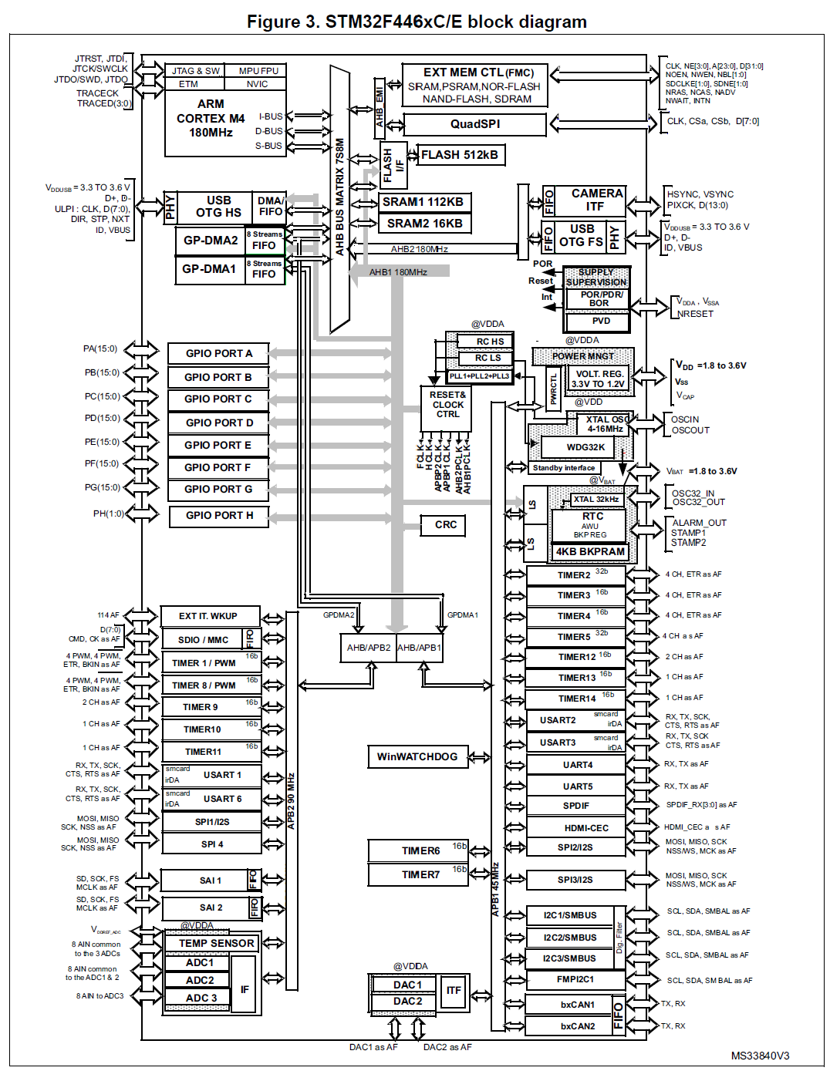
STM32F446RE Block Diagram of the System Architecture
For better view click on this.

Slide 13
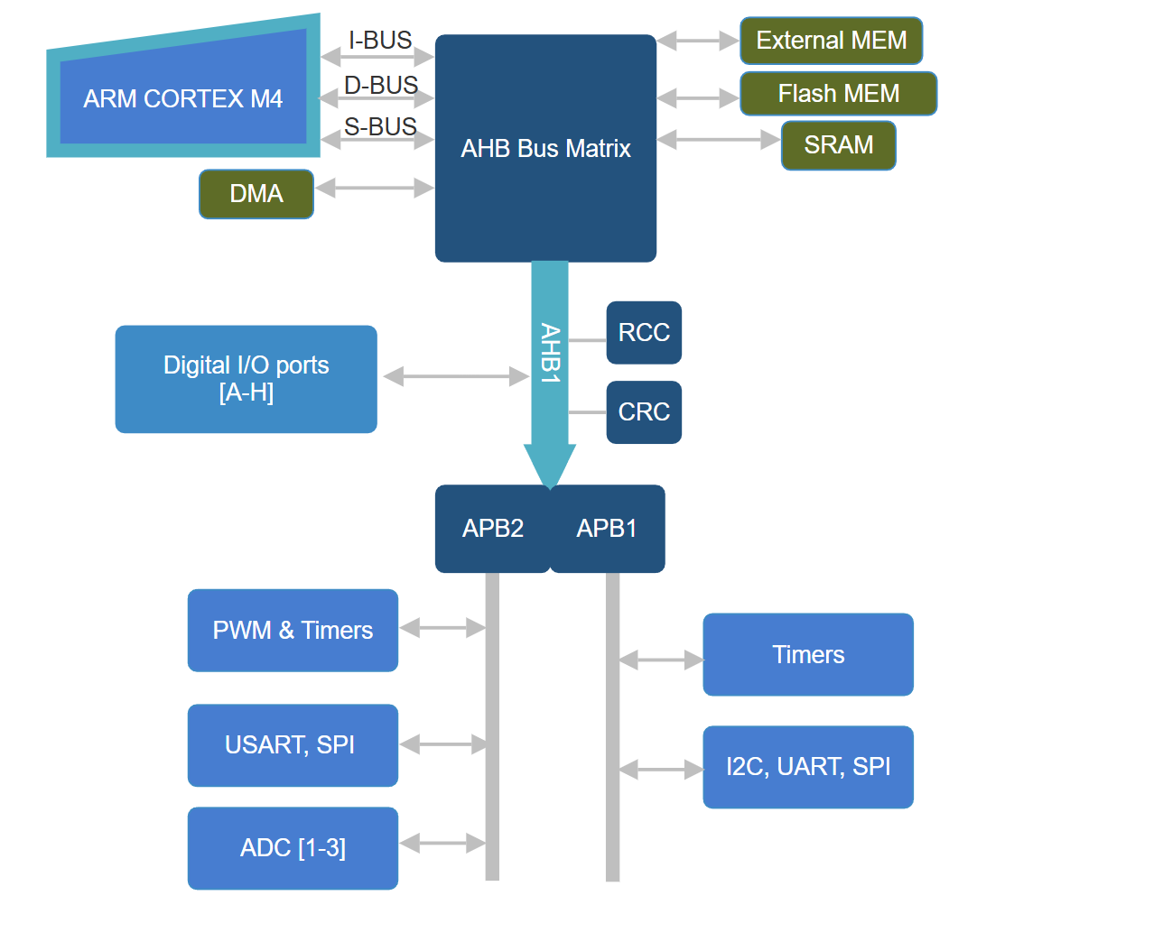
System Architecture [Simplified - Only AHB1]
DMA: Direct Memory Access
AHB: Advanced High-performance Bus
APB: Advanced Peripheral Bus
RCC: Reset and Clock Control
CRC: Cyclic Redundancy Check
PWM: Pulse with Modulation
USART: universal synchronous/ asynchronous receiver/transmitter
SPI: Serial Peripheral Interface
I2C: Inter-Integrated Circuit
ADC: Analog to Digital Converter

Slide 14
Memory & Bus Architecture
I-bus: This bus connects the Instruction bus of the Cortex M4 with FPU core to the Bus Matrix. This bus is used by the core to fetch instructions.
D-bus: This bus connects the databus of the Cortex M4 with FPU core to the Bus Matrix. This bus is used by the core for literal load and debug access. The target of this bus is a memory containing code or data.
S-bus: This bus connects the system bus of the Cortex M4 with FPU core to the Bus Matrix. This bus is used to access data located in a peripheral or in SRAM. Instructions may also be fetch on this bus (less efficient than I-bus).

Slide 15
Memory & Bus Architecture
DMA, Flash MEM, External MEM, SRAM
AHB Bus Matrix
APB Buses: The two APB bridges, APB1 and APB2, provide full synchronous connections between the AHB and the two APB buses, allowing flexible selection of the peripheral frequency. After each device reset, all peripheral clocks are disabled (except for the SRAM and Flash memory interface). Before using a peripheral you have to enable its clock in the RCC_AHBxENR or RCC_APBxENR register.

Slide 16
CRC & RCC
Cyclic Redundancy Check (CRC)
The CRC calculation unit is used to get a CRC code from a 32-bit data word and a fixed generator polynomial. Among other applications, CRC-based techniques are used to verify data transmission or storage integrity.
Reset and Clock Control (RCC)
There are three types of reset
System Reset
Power Reset
Backup domain Reset

Slide 17
To use different I/O ports, NEED TO CONFIGURE DIFFERENT REGISTERS
RCC AHB Peripheral Clock Enable Register
GPIO Registers
Four configuration registers
Two data registers
Set/reset register
Locking register
Two alternate function selection

Slide 18
GPIO
Input
Output
Alternate Function
Digital Input
Analog Input
Digital Output
Communication Protocol
Time (PWM)
Input floating
Input pull-up
Input-pull-down
Speed (Low, Medium, Fast, High)
USART
SPI
I2C
CAN
Push Pull
Open Drain
No pull up/down
Pull-up
Pull-down

Slide 19
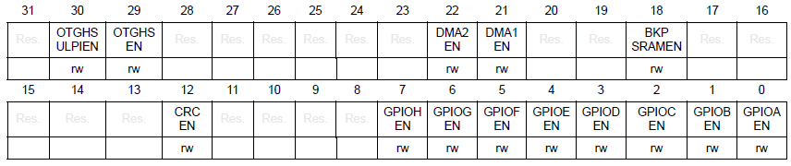
RCC AHB Peripheral Clock Enable Register [RCC->AHB1ENR]
32 bit register
Can enable port any digital I/O port [A-H]
Can enable DMAs
Can enable CRC

Slide 20
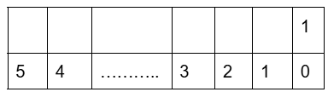
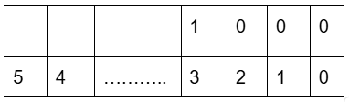
RCC AHB Peripheral Clock Enable Register [RCC->AHB1ENR]
BIT 0 - GPIOA EN: I/O port A clock enable
0: IO port A clock disabled
1: IO port A clock enabled
BIT 1 - GPIOB EN: I/O port B clock enable
0: IO port B clock disabled
1: IO port B clock enabled
…….. and so on
Example:
RCC->AHB1EN |= 1<<0 [Port A activated]
RCC->AHB1EN |= 1<<3 [Port D activated]

Slide 21
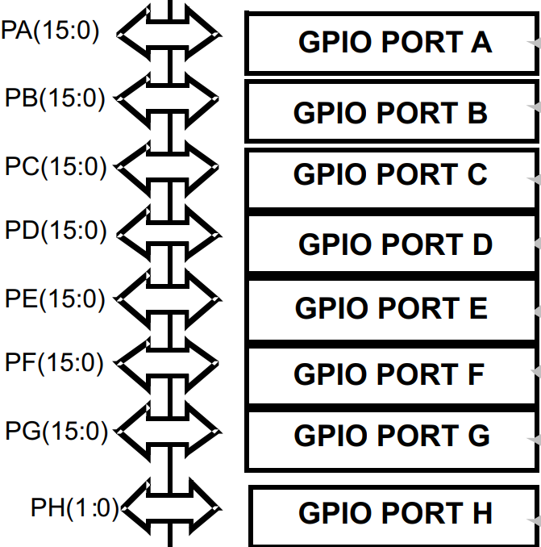
General Purpose I/0 [GPIO]
Each general-purpose I/O port has -
A four 32-bit configuration registers
GPIOx_MODER: Mode Register
GPIOx_OTYPER : Output Type Register
GPIOx_OSPEEDR : Output Speed Register
GPIOx_PUPDR) : Pull-up, Pull-Down Register
Two 32-bit data registers
GPIOx_IDR: Input Data Register
GPIOx_ODR: Output Data Register
A 32-bit set/reset register (GPIOx_BSRR),
A 32-bit locking register (GPIOx_LCKR)
Two 32-bit alternate function selection
GPIOx_AFRH: Alternetive Register High
GPIOx_AFRL : Alternetive Register Low

Slide 22
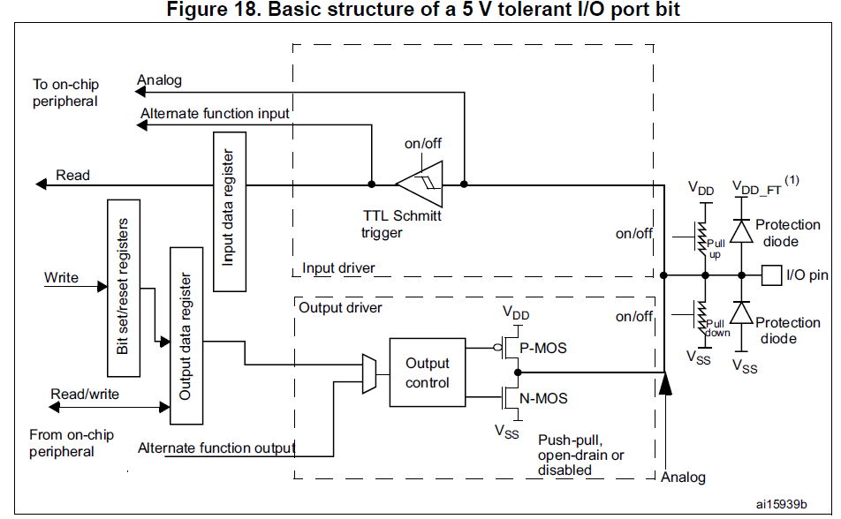
Internal Interfacing Unit of each GPIO PORT

Slide 23
General Purpose I/0 [GPIO]
Each general-purpose I/O port has -
A four 32-bit configuration registers
GPIOx_MODER: Mode Register
GPIOx_OTYPER : Output Type Register
GPIOx_OSPEEDR : Output Speed Register
GPIOx_PUPDR) : Pull-up, Pull-Down Register
Two 32-bit data registers
GPIOx_IDR: Input Data Register
GPIOx_ODR: Output Data Register
A 32-bit set/reset register (GPIOx_BSRR),
A 32-bit locking register (GPIOx_LCKR)
Two 32-bit alternate function selection
GPIOx_AFRH: Alternetive Register High
GPIOx_AFRL : Alternetive Register Low

Slide 24
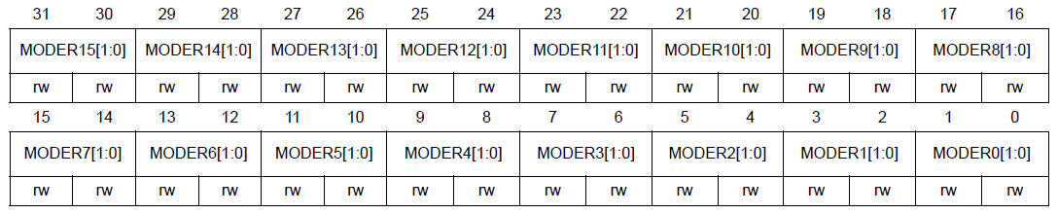
GPIO Configuration Registers (IO Mode Register)
GPIOx_MODER ( x = A..H ) : These bits configure the I/O direction mode.
00: Input (reset state)
01: General purpose output mode
10: Alternate function mode
11: Analog mode
Bit [0..31]: MODERy[1:0]: Port x configuration bits (y = pin = 0...15)

Slide 25
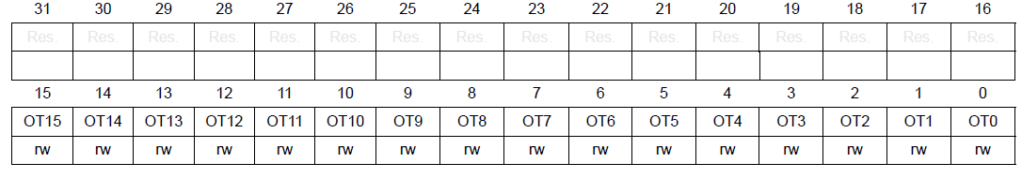
GPIO Configuration Registers (Output Type Register)
GPIOx_OTYPER (x=A..H):These bits are written by software to configure the output type of the I/O port.
0: Output push-pull (reset state)
1: Output open-drain
Bits 31:16 - Reserved
Bits 15:0 - OTy: Port x configuration bits (y = 0..15)

Slide 26
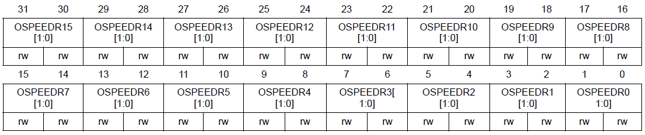
GPIO Configuration Registers (Output Speed Register)
GPIOx_OSPEEDR (x=A..H): These bits are to configure the I/O output speed.
00: Low speed
01: Medium speed
10: Fast speed
11: High speed
OSPEEDRy[1:0]: Port x configuration bits (y = 0..15)

Slide 27
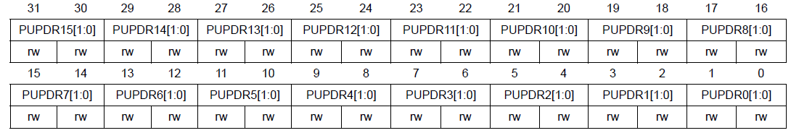
GPIO Configuration Registers (Pull-up Pull-down Register)
GPIOx_PUPDR (x=A..H): These bits are written to configure the I/O input pull-up or pull-down
00: No pull-up, pull-down
01: Pull-up
10: Pull-down
11: Reserved
Bits[0..31] - PUPDRy[1:0]: Port x configuration bits (y = 0..15)

Slide 28
General Purpose I/0 [GPIO]
Each general-purpose I/O port has -
A four 32-bit configuration registers
GPIOx_MODER: Mode Register
GPIOx_OTYPER : Output Type Register
GPIOx_OSPEEDR : Output Speed Register
GPIOx_PUPDR) : Pull-up, Pull-Down Register
Two 32-bit data registers
GPIOx_IDR: Input Data Register
GPIOx_ODR: Output Data Register
A 32-bit set/reset register (GPIOx_BSRR),
A 32-bit locking register (GPIOx_LCKR)
Two 32-bit alternate function selection
GPIOx_AFRH: Alternetive Register High
GPIOx_AFRL : Alternetive Register Low

Slide 29
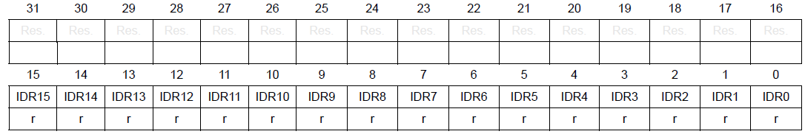
2. Data Registers (Input Data Register)
GPIOx_IDR (x=A..H): These bits are read-only. They contain the input value of the corresponding I/O port.
Bits 31:16 - Reserved
Bits 15:0 - IDRy: Port input data (y = 0..15)

Slide 30
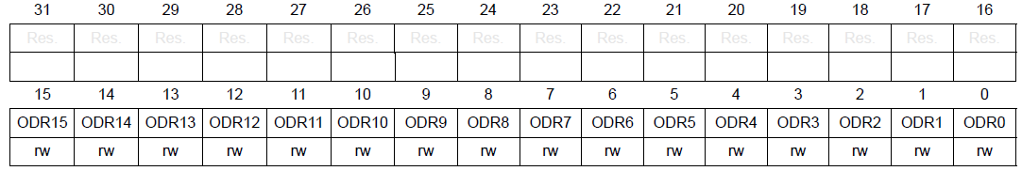
2. Data Registers (Output Data Register)
GPIOx_ODR (x=A..H): These bits can be read and written
Bits 31:16 - Reserved
Bits 15:0 - ODRy: Port output data (y = 0..15)
Note: For atomic bit set/reset, the ODR bits can be individually set and reset by writing to the GPIOx_BSRR register (x = A..H).

Slide 31
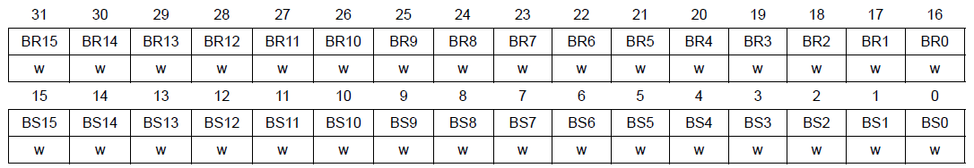
3. Set/Rest Register (Bit Set Reset Register)
GPIOx_BSRR (x=A..H): These bits are write-only and can be accessed in word, half-word or byte mode.
Bits 15:0 - BSy: Port x set bit y (y= 0..15)
0: No action on the corresponding ODRx bit
1: Sets the corresponding ODRx bit
Bits 31:16 - BRy: Port x reset bit y (y = 0..15)
0: No action on the corresponding ODRx bit
1: Resets the corresponding ODRx bit
Note: If both BSx and BRx are set, BSx has priority.

Slide 32
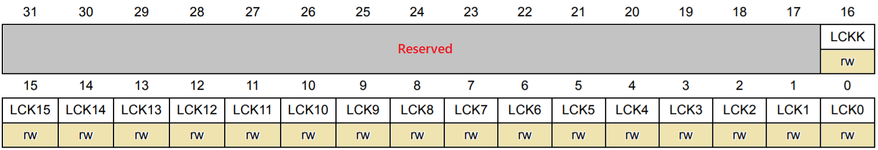
4. Locking register Register
GPIOx_LCKR: (x=A..H): Using this register, you can freeze the GPIO configurations. Once you do the proper lock key write sequence, it will lock the GPIOx_MODER, GPIOx_OTYPER, GPIOx_OSPEEDR, GPIOx_PUPDR, GPIOx_AFRL, and GPIOx_AFRH registers.
Bits [15:0] – LCKy: Port Set Bit, (y = 0 … 15)
0 – Port configuration is not locked
1 – Port configuration is locked
Bits [16] – LCKK: Lock Key
0 – Port configuration lock key is not active
1 – Port configuration lock key is not active

Slide 33
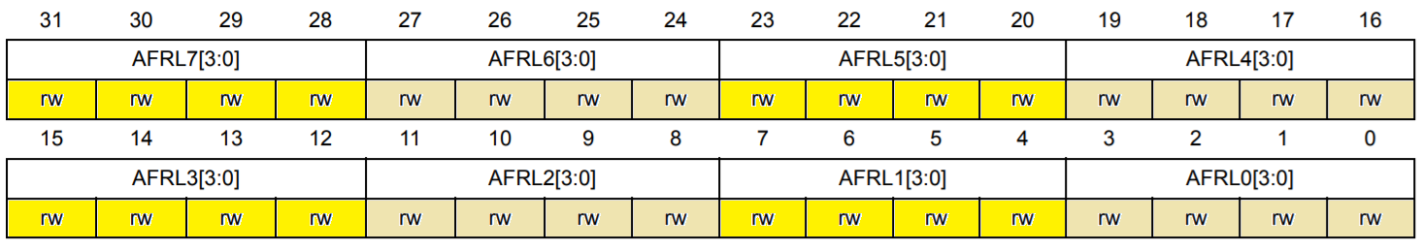
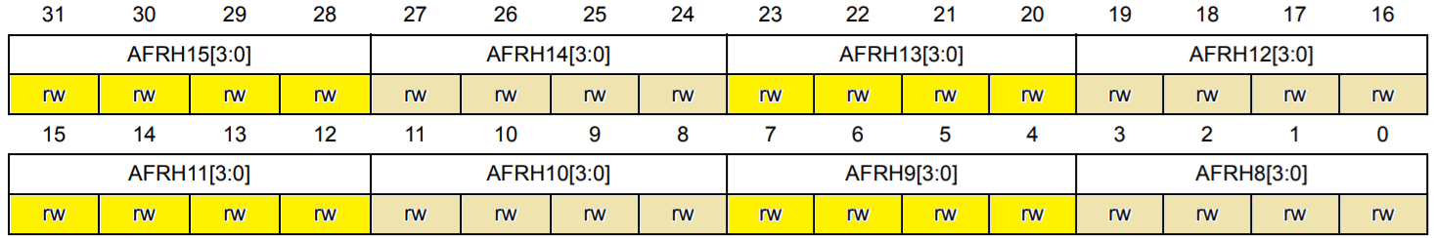
5. Alternate function selection Register
GPIOx_AFRL: (x=A..H) , GPIOx_AFRH: (x=A..H): Each GPIO pin has around sixteen alternative functions like SPI, I2C, UART, etc. So we can tell the STM32 to use our required functions.
GPIOx_AFRL 32-bit register is grouped by 4 bits. So This GPIOx_AFRL register is used to select the alternate functions of Pin 0 to Pin 7
GPIOx_AFRH 32-bit register is also grouped by 4 bits. So This GPIOx_AFRH register is used to select the alternate functions of Pin 8 to Pin 15
0000: AF0 (Alternate Function 0)
0001: AF1 (Alternate Function 1)
0010: AF2 (Alternate Function 2)
0011: AF3 (Alternate Function 3)
……..
1111: AF15 (Alternate Function 15)

Slide 34
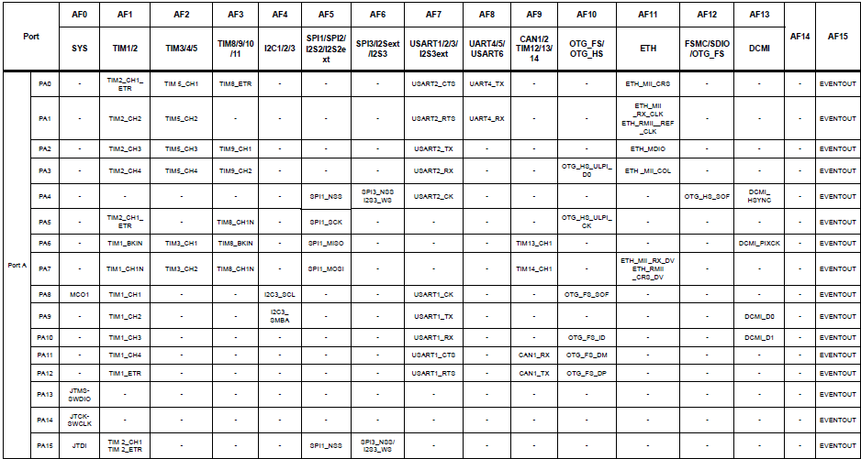

Slide 35
THANK YOU!

